Slide 1
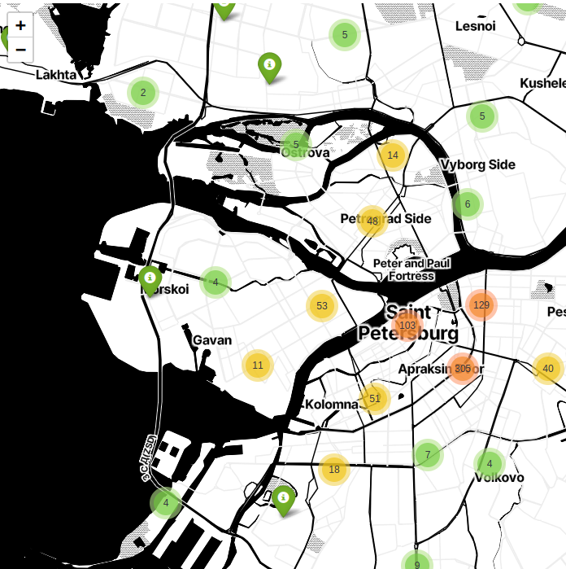
Saint Petersburg Literary Space 1999-2019
ADA Lab 2023 DHDK / Maria Levchenko
Notes:
My project is about applying data extraction and data analysis to the sociology of literature in order to describe and gain insight into the literary field of St. Petersburg.

Slide 2
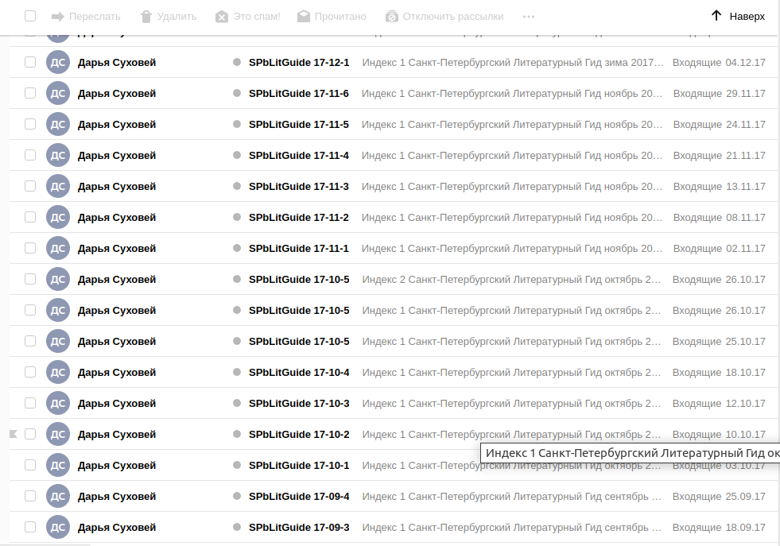
Initial textual data
1154 newsletter’s issues
sent from 1999 to 2019
contains the list of upcoming literary events in Saint Petersburg
in Russian
Notes:
My initial data was a corpus of newsletters announcing literary events in St. Petersburg from 1999 to the present.
Daria Sukhovey, a poet from St. Petersburg, has been maintaining these newsletters for almost 25 years. She has done a great job of collecting, organizing, and sharing information about all kinds of literary events. What's really impressive about her newsletter is how consistent it has been over the years and how it covers a wide and diverse range of events: book presentations, poetry slams, meetings with readers, public debates, book fairs, and so on.
It usually comes out 3 to 5 times a month, so when I decided to get 20 years of issues, I ended up with more than 1,000 records.

Slide 3

Goals
Transform the corpus of newsletters into structured dataset
Analyze the literary space of Saint Petersburg
Notes:
To use it as a basis for studies in the sociology of literature, I wanted to transform the corpus of newsletters into a structured dataset, thus providing a basis for quantitative and network analysis. And then to make a preliminary analysis of this dataset in order to understand the literary scene of St. Petersburg.

Slide 4
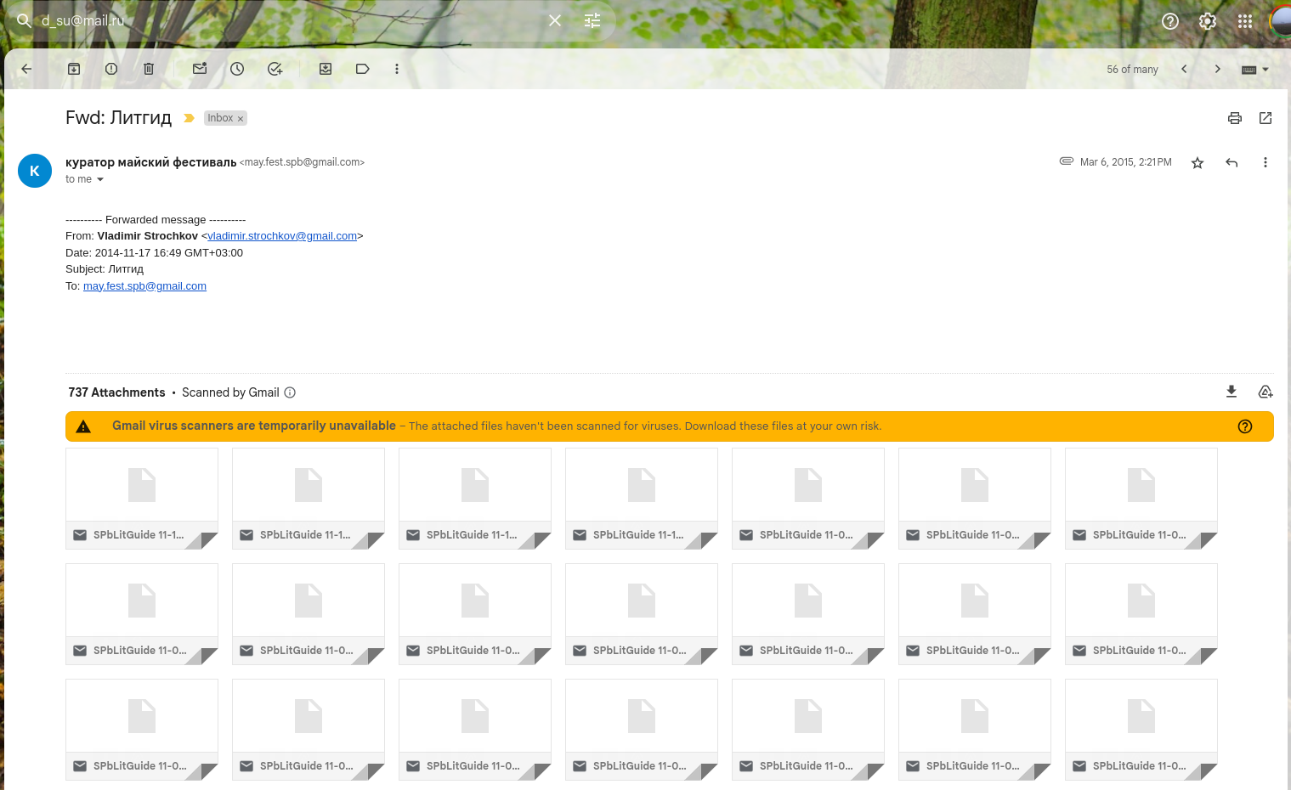
Conversion: eml — WordPress — XML
Notes:
Originally, the corpus consisted of electronic letters (EML files). A few years ago, I helped Daria move to a more stable hosting by converting these files into a WordPress website. This was the basis for my current project.
That's why when I started it, I only had to import a 62 Mb XML file from the WordPress SQL database.

Slide 5
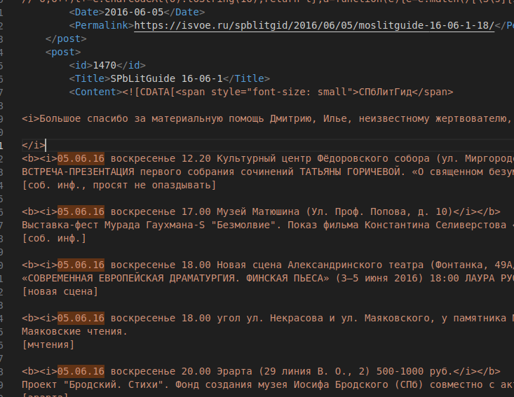
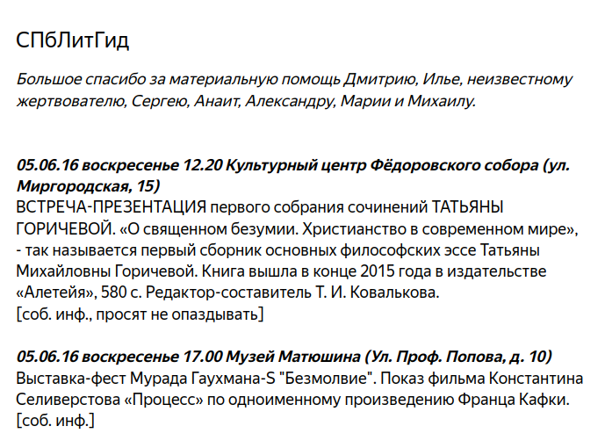
What it looked like
Notes:
This file is relatively structured, with each entry corresponding to a newsletter issue and describing 10 to 20 events.
For each event, you know the date, weekday, time, location, and address. Typically, this information is highlighted in the first line of the event block using HTML tags such as bold and italic.
Next is the text of the event description (it can be very long or very short, and usually contains the names of the people who will be attending or organizing the event).
And the last line is a short note about the source of the information.

Slide 6
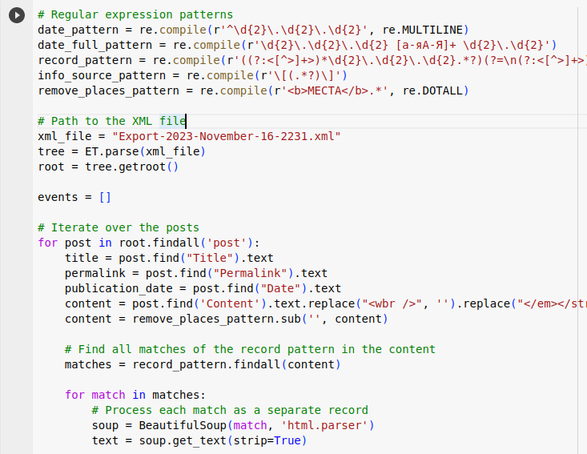
Data cleaning with Python and common sense
Pandas
Difflib
BeautfoulSoup
Natasha
DeepPavlov
Colab Notebook
Notes:
I parsed and cleaned this XML file into a Pandas dataframe using Python. I used BeautifulSoup for HTML parsing, regexp for date and time extraction, and the Natasha library for address identification.

Slide 7
difflib.Differ()
Библиотека им. Маяковского
Библиотека Маяковского
ЦГПБ им. В.В. Маяковского
Наб. р. Фонтанки, 46
Фонтанка, д. 46
Фонтанка, 46
Наб. реки Фонтанки, д. 46
Библиотека им. Маяковского
Фонтанка, д. 46
Notes:
I then used the difflib package to find different spellings or typos in place names and addresses using Levenshtein distance, and I was able to extract and standardize it.
Events are often announced in multiple issues of the newsletter; for example, an event on March 28 might be listed in five issues starting in February, and sometimes the description changes from one issue to the next. The difflib package has been useful in identifying and handling these duplicates.

Slide 8
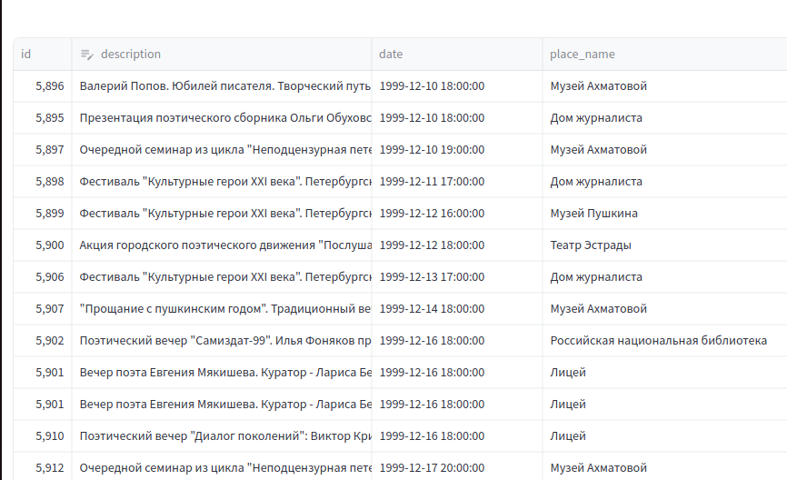
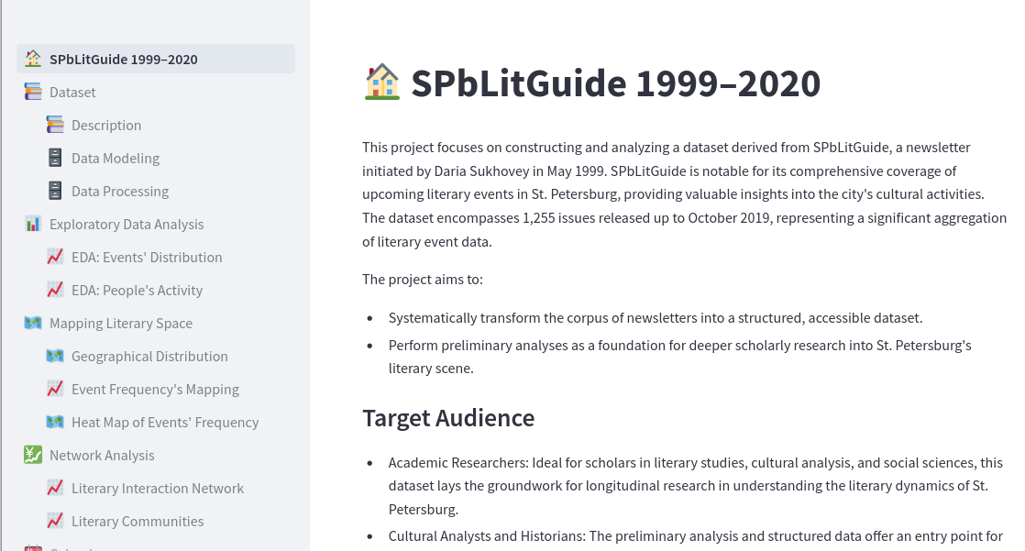
Tidy data
Notes:
As a result, I have a Pandas dataframe with clean data.
To make this data accessible and interactive, I used Streamlit to create a web application.

Slide 9
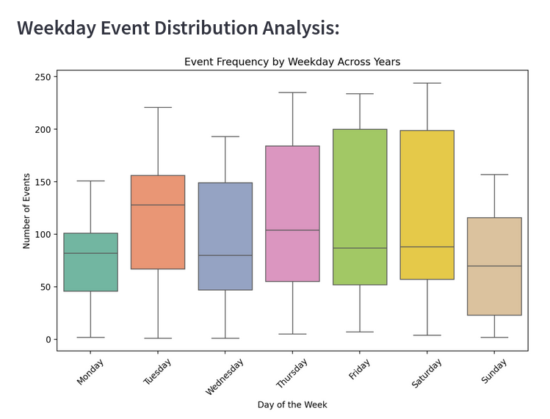
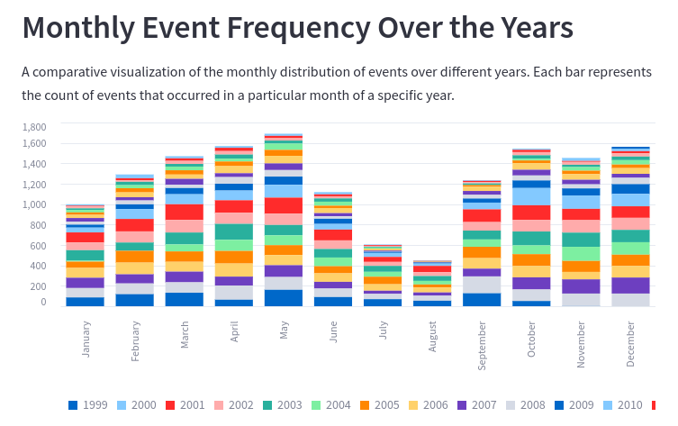
EDA
Notes:
Streamlit allows you to create a wide variety of charts and plots based on your Pandas dataframe. And here are two examples of simple exploratory data analysis based on the datetime value: a stacked chart of monthly event frequency for each year, and a box plot detailing event frequency by weekday over the years.

Slide 10
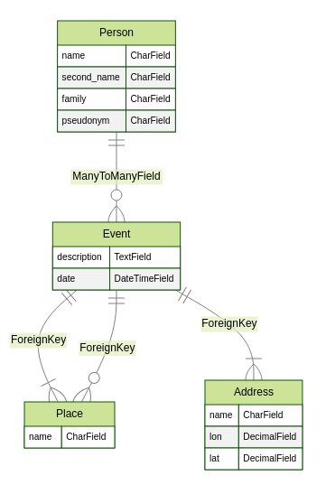
df.describe()
13 248 unique events
862 venues
817 addresses
Notes:
In my dataframe, there are more than 13 thousand unique events and more than 8 hundred unique cultural places and addresses.
The disparity between the number of locations and addresses is due to location changes over twenty years and multiple organizations sharing a single address. A prime example is a downtown hipster hub that houses a variety of cultural spots such as a bookstore, a nightclub, and an exhibition space.
So my data model needs to distinguish between these classes of data.

Slide 11
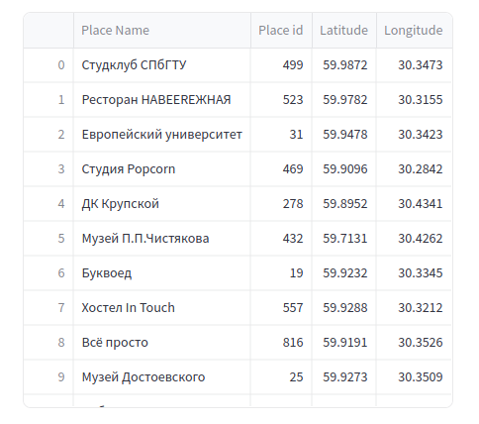
Yandex Geocoder API
Notes:
Extracting unique addresses allows me to enrich my data with geographic coordinates using Yandex API: I added latitude and longitude for each of them.
Using this information, I placed eight hundred markers on the map to represent the locations.
This map can also be seen and explored on the website.

Slide 12
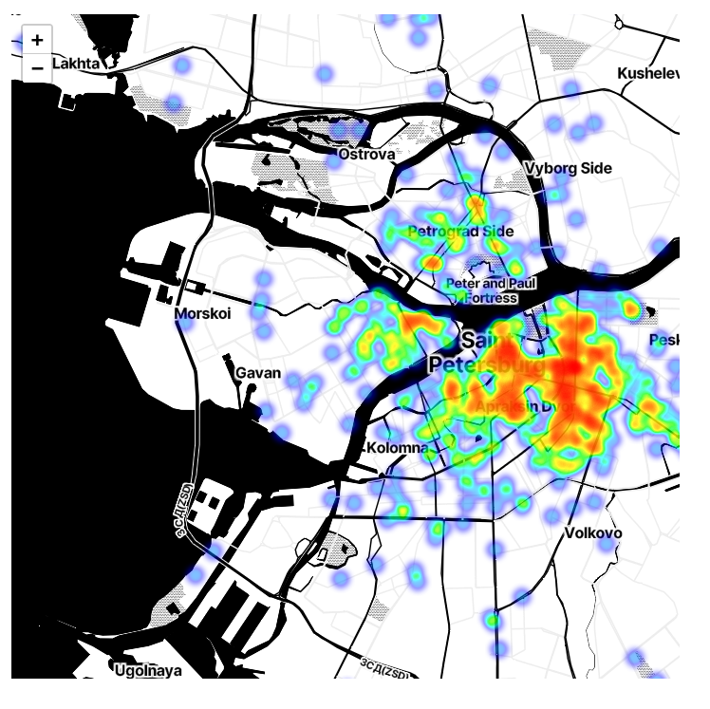
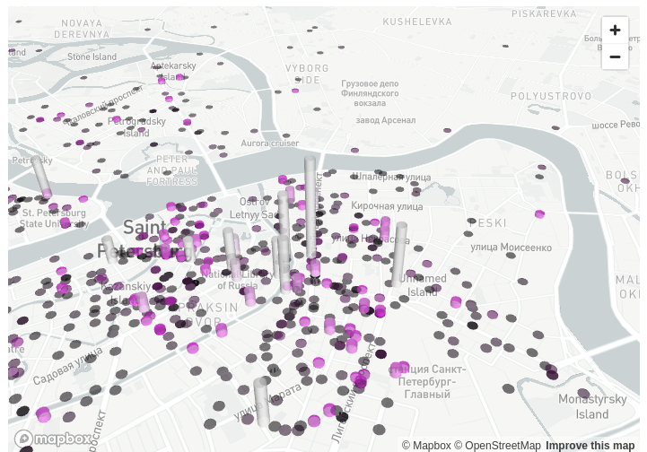
Geographical Distribution of events
Notes:
By combining and counting the number of events that took place in each location, I've created a heat map of the distribution of events across the city map, and can see which regions of Saint Petersburg were more active during those twenty years.
I prefer the heat map to the three-dimensional view because it shows more clearly where literary activity is concentrated.

Slide 13
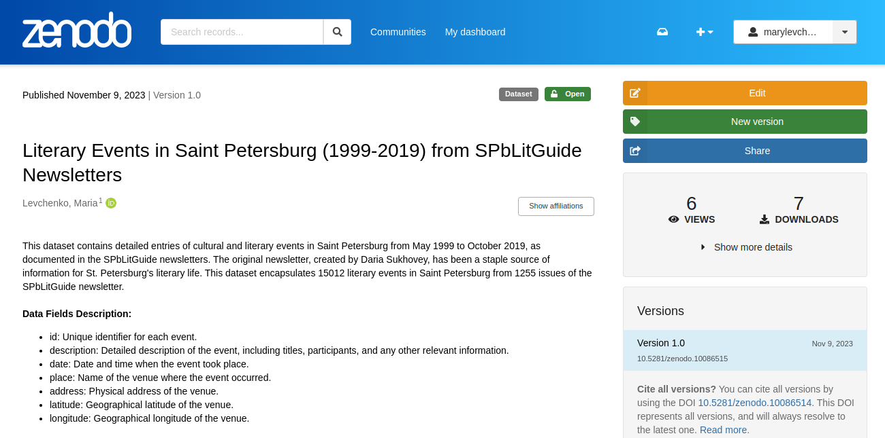
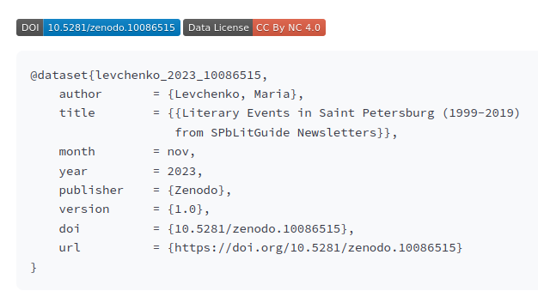
Dataset at Zenodo
Notes:
This enriched dataset was published on Zenodo and even downloaded several times, but my project didn't end there.
What I was really interested in with this dataset is the social connections and collaboration between actors in the literary space of St. Petersburg.
My idea was about the importance of co-participation in events to trace the connections between the literary groups and key actors.

Slide 14
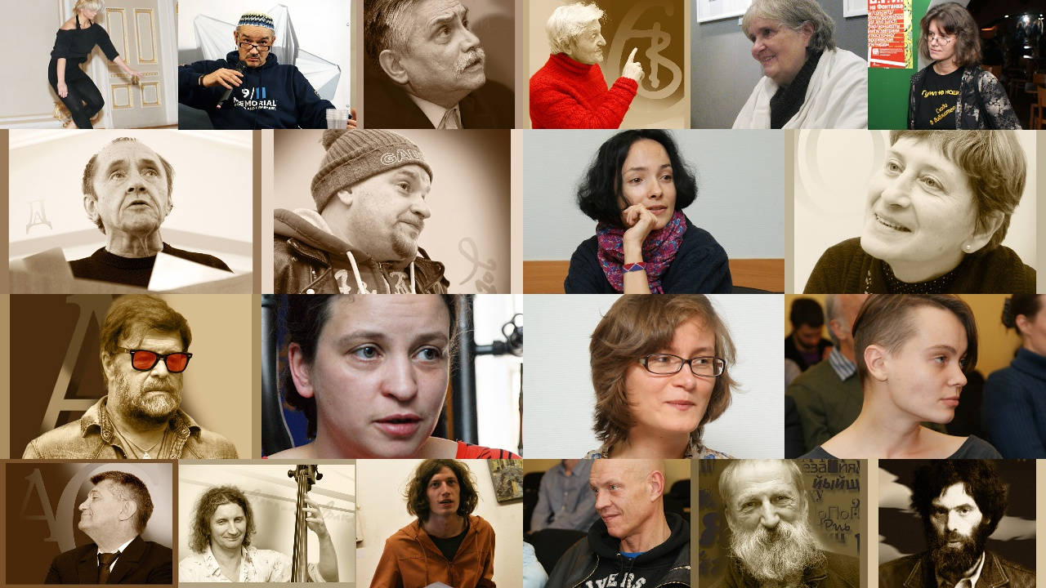
Notes:
These groups range from traditional to avant-garde poets, non-fiction writers, rock stars, feminist researchers and uncontrolled writing enthusiasts. And, of course, there are several key figures in St. Petersburg's literary landscape who set trends in their respective fields. When they act in public, they inevitably form different groups and connections. And I wanted to show the whole picture of these relations on the basis of their only public (non-publishing) activity.

Slide 15


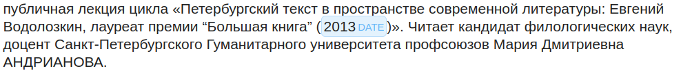
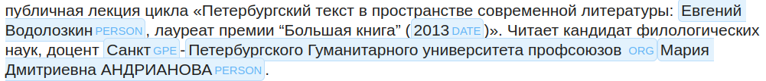
Named Entity Recognition
DeepPavlov
ChatGPT-4
Notes:
But to do that, I have to extract the names of the participants from the event descriptions.
I did this using the DeepPavlov library and its pre-trained neural network model. This tool was effective for the Russian language, but not without errors. It successfully extracted a list of names and surnames, which I had to review and refine for accuracy.
I also explored the use of large language models, namely ChatGPT-3.5 and ChatGPT-4, for name extraction. These models provided excellent performance, but they were not included in the final version of the dataset due to their slower processing speed and higher computational cost. I will leave this for the future.

Slide 16
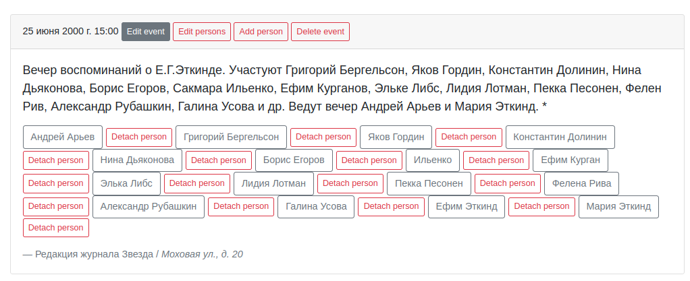
Person connected to the event
14 975 persons
Notes:
As a result, I have a comprehensive list of people connected to each event and can perform detailed statistical analysis of event engagement and key player activity.
Of note, nearly 15,000 people participated in these events. These people played key roles such as speakers, authors, or organizers.
And when people are mentioned together in an event description, it implies that they have cultural ties. This could be collaborations on book projects, shared memberships in literary groups, or similar aesthetical preferences.

Slide 17
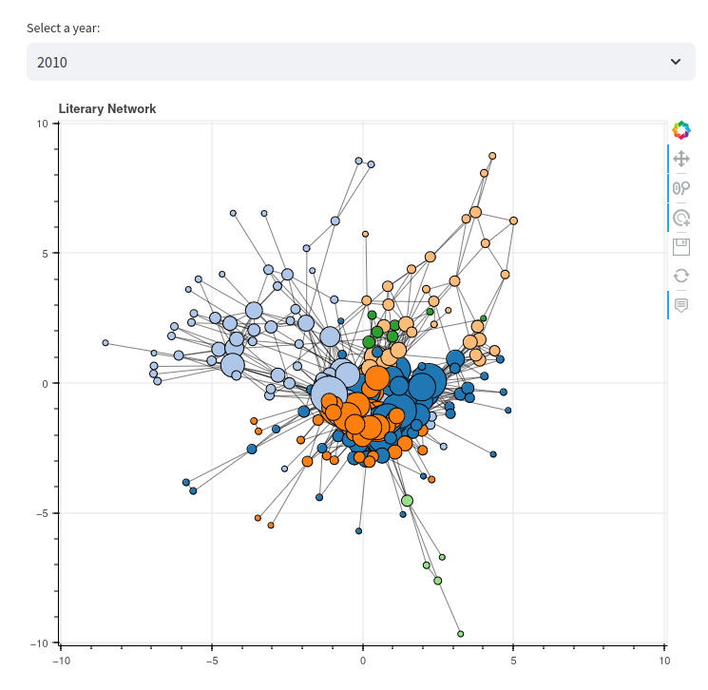
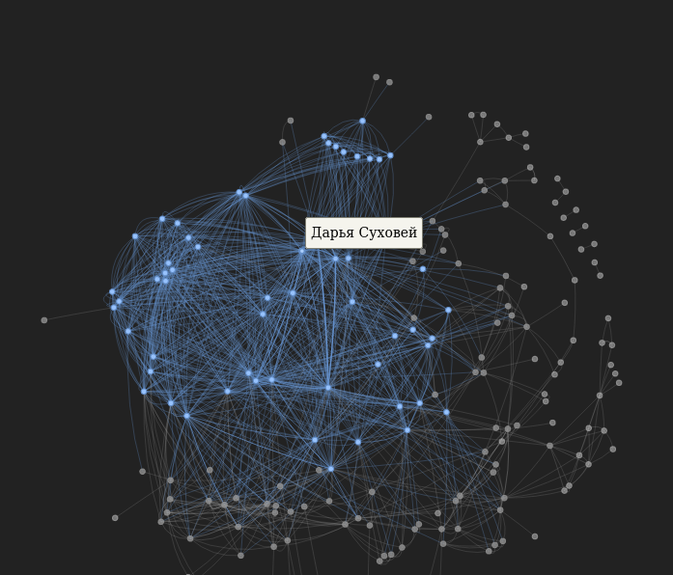
Literary Network
Notes:
I used data on shared event participation to map the connections between these literary actors. This is visualized in a network graph.
The graph shows the relationships and collaborations among St. Petersburg literary figures year by year. In this graph, each point or 'node' represents a literary actor, and the connecting lines or 'edges' indicate their collaboration in an event.
Using network analysis tools (spring layout algorithm), we could identify different communities within the literary field and use them for future research and analysis.
The Pyvis and Bokeh libraries give us a simple visual representation to analyze the closeness of interactions between different actors.

Slide 18
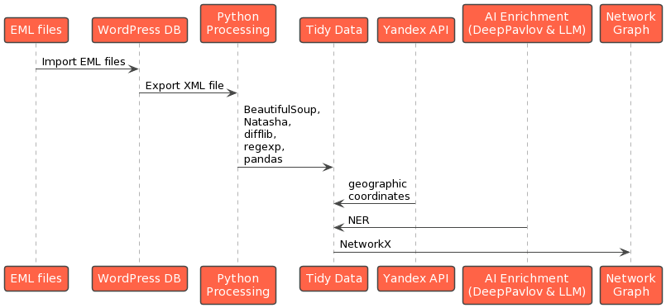
Data Pipeline
Notes:
And the last slide shows us a whole pipeline of data extraction and enrichment.
So this project lays the groundwork for future exploration and understanding of this dynamic community. Of course this dataset has its limitations but it is also open to the future improvements.
For instance, we can extract organization names from event descriptions and create a community graph that illustrates the connections between individuals and each cultural organization in Saint Petersburg.
We can track the changes in the community graph year by year or classify event types to explore the dynamics, and so on.
But that’s all for now. Thank you for your attention.

